Slide 1
Early Career Researchers
Brazilian Team
Beatriz Kalichman, Cecília Guida, Marina dos Reis, Nayara Portilho Lima, Stephanie Pereira
Workshop HERA 2
Palestine
2022

Slide 2
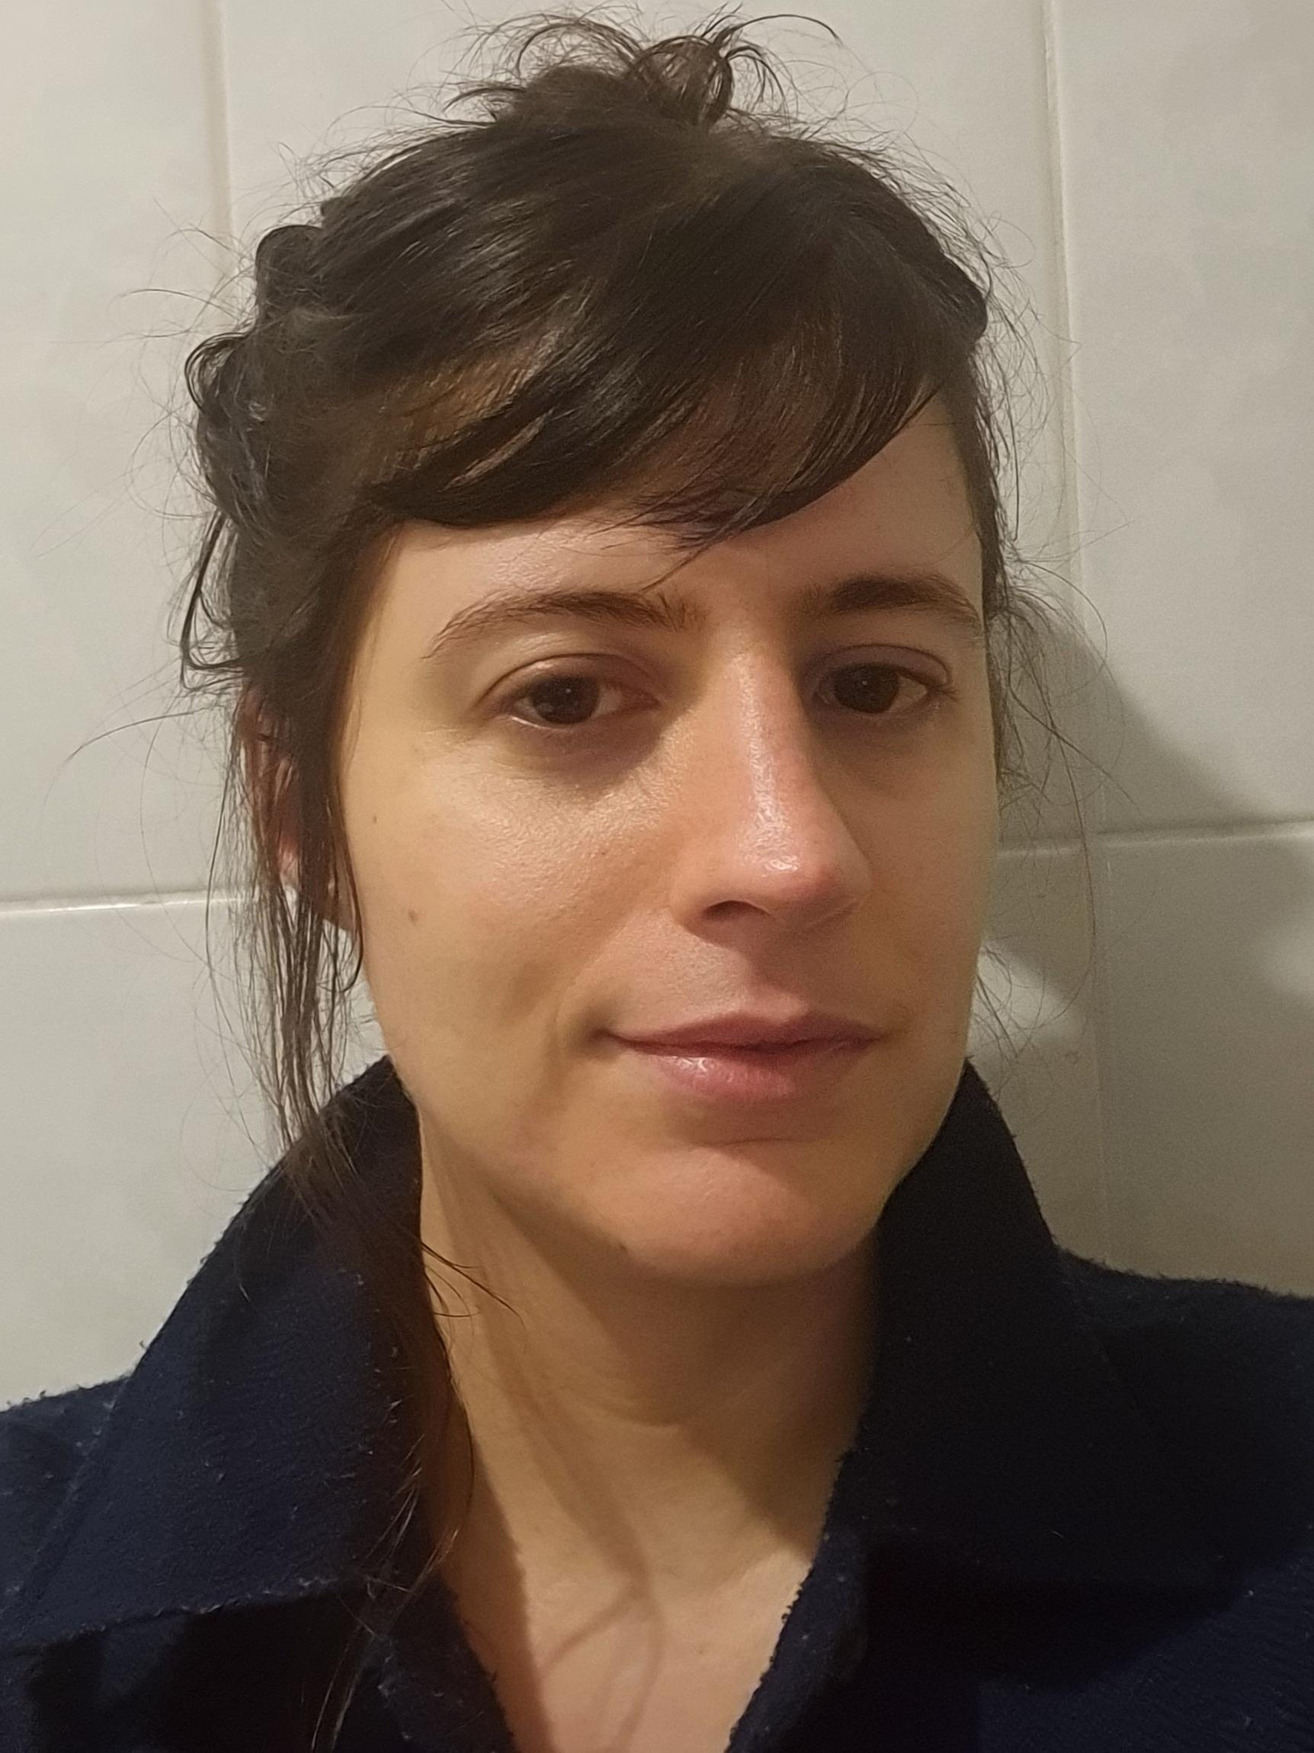
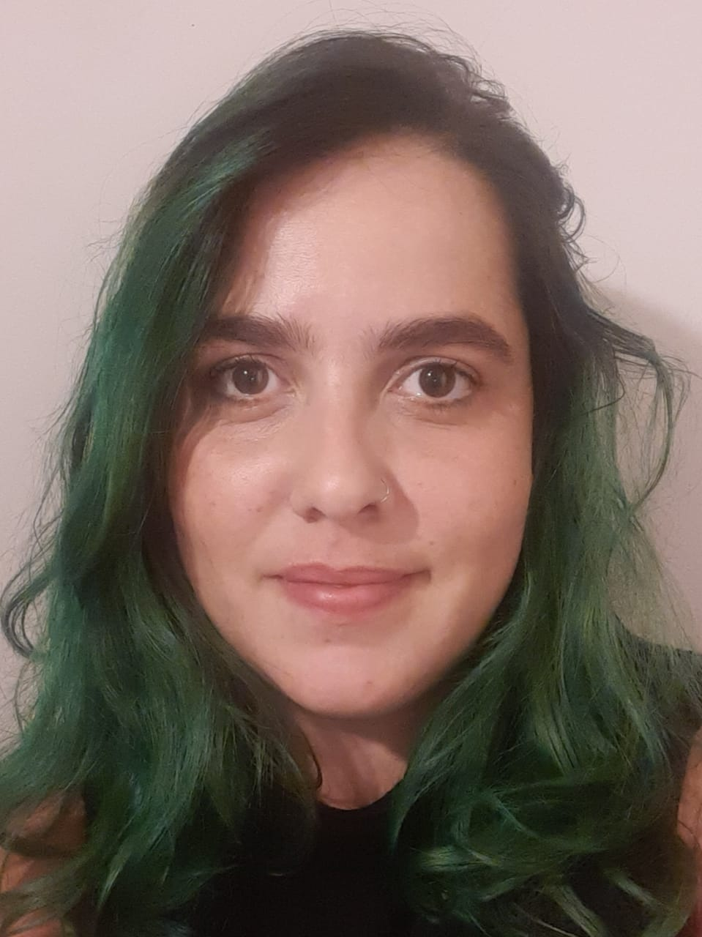
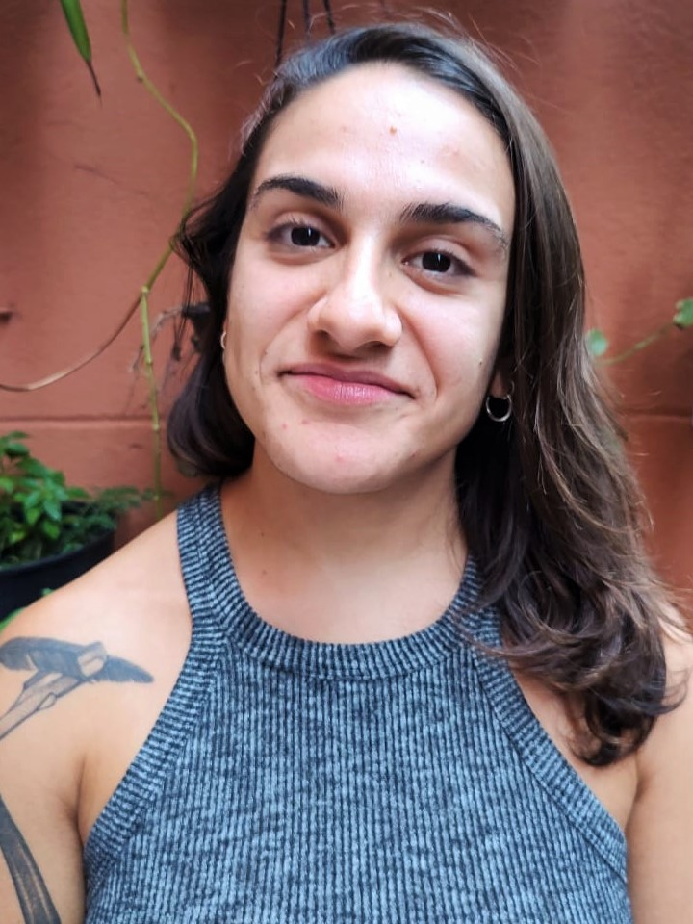
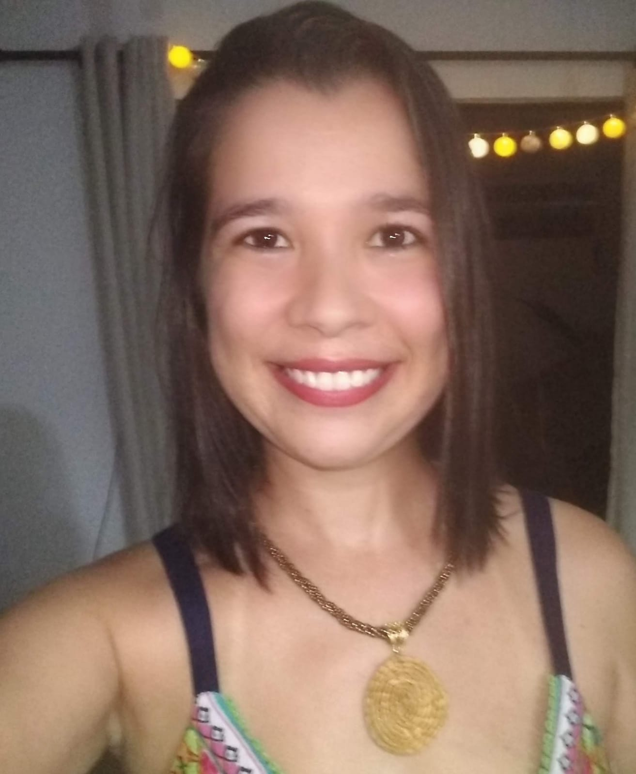
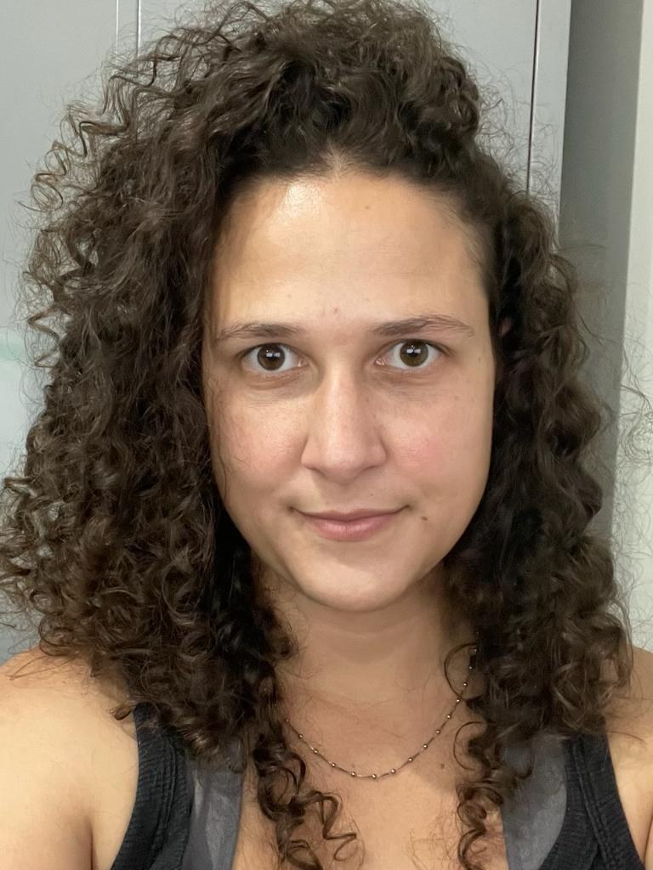
Who we are
Beatriz, 30, Public Policy Management
Master in Urban Planning
In HERA since 2019, 40h/week
Cecília, 31, Psychologist
In HERA since 2017, 35h/week
Marina, 29, Psychologist
Multidisciplinary Residency in PHC
In HERA since 2020, 40h/week
Nayara, 32, Psychologist
Multidisciplinary Residency in PHC
Master Student
In HERA since 2019, 28h/week
Stephanie, 30, Nurse
Multidisciplinary Residency in PHC
Master in Preventive Medicine
PhD Student
In HERA since 2017, 40h/week

Slide 3
Data production and analysis
Revision and adaptation of qualitative topic guides, PIM and questionnaires | X | X | X | X | X
Qualitative interviews with local managers and providers | X | X | X | X | X
Longitudinal follow up with women |  |  |  |  | X
Cost extension interviews with managers | X
Audio checking, disidentification and editing | X | X | X | X | X
Coding | X | X | X | X | X
Field observation and field notes | X | X | X | X | X
Administering questionnaires | X | X |  |  | X
Writing of reports and papers | X | X | X | X | X
What we do

Slide 4
Implementing the intervention
Training sessions (training of the trainers and general training) | X | X | X | X | X
Adaptation of the intervention | X | X | X | X | X
Follow up of the clinics and support | X | X | X | X | X
Supervision sessions | X | X | X | X | X
What we do

Slide 5
Strengthening the group and the intervention
Weekly meetings | X | X | X | X | X
Bi-weekly supervision meeting |  | X | x | X
International monthly meeting | X |  |  |  | X
Multi Agency network meeting |  | X | x
Interlocution with stakeholders | X | X | X | X | X
Confad (who did it and who does it currently) |  | X | X | X (2019) | X (2014-2016/ 2017-2019)
Project management | X |  |  |  | X
What we do

Slide 6
Capacity Strengthening
Workshop and short courses | X | X | X | X | X
Post graduation |  |  |  | X | X
English classes |  | X | X | X
HERA workshops | X | X | X | X | X
ECR meetings | X |  |  |  | X
ECR Joint training lead | X
What we do

Slide 7
Key things we have learnt
The importance of the quality of the relationship between research/ researchers and the healthcare services
How to adapt the research to the adversities we encountered (covid pandemic, service turnover, political moment, change in municipal management)
How to use research tools
The things about doing research that you only learn doing research

Slide 8
What we enjoyed
Teamwork
Incentives to our education and training
Participating in congresses and seminars
Financial support and resources
The multicentric aspect of the research
ECR workshops/ meetings

Slide 9
What we found hard
Doing research during the pandemic
Doing research in services that are going through a lot of difficulties
Instability of financing (continuity of research group)

Slide 10
What we want to do next and what support we need
Progress in our academic qualification. For that we need: funding and protected time
Continue doing research. For that we need: financing
Placements in academia and services. For that we need: public policies and a new government that invests in education and health

Slide 11
Thank you!

